Slide 1

Driving environment perception framework based on image segmentation with traffic object content identification
Group members: Jie Li, Yong Zhang, Peipei Zhu, Junpeng Zhang
CUHKSZ Conference on Image Processing & Computer Vision 2018

Slide 2
Overview
Introduction
Methods
Experiments
Conclusion

Slide 3
Background

Slide 4
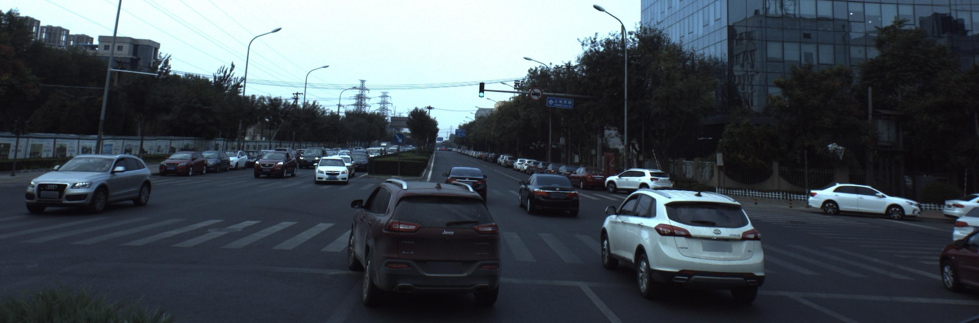
What?
Driving environment
Notes:
Driving environment - What is around the car when it is running on the road?
One important way to percept driving environment is to analyze the real-time images captured by cameras on the car.

Slide 5
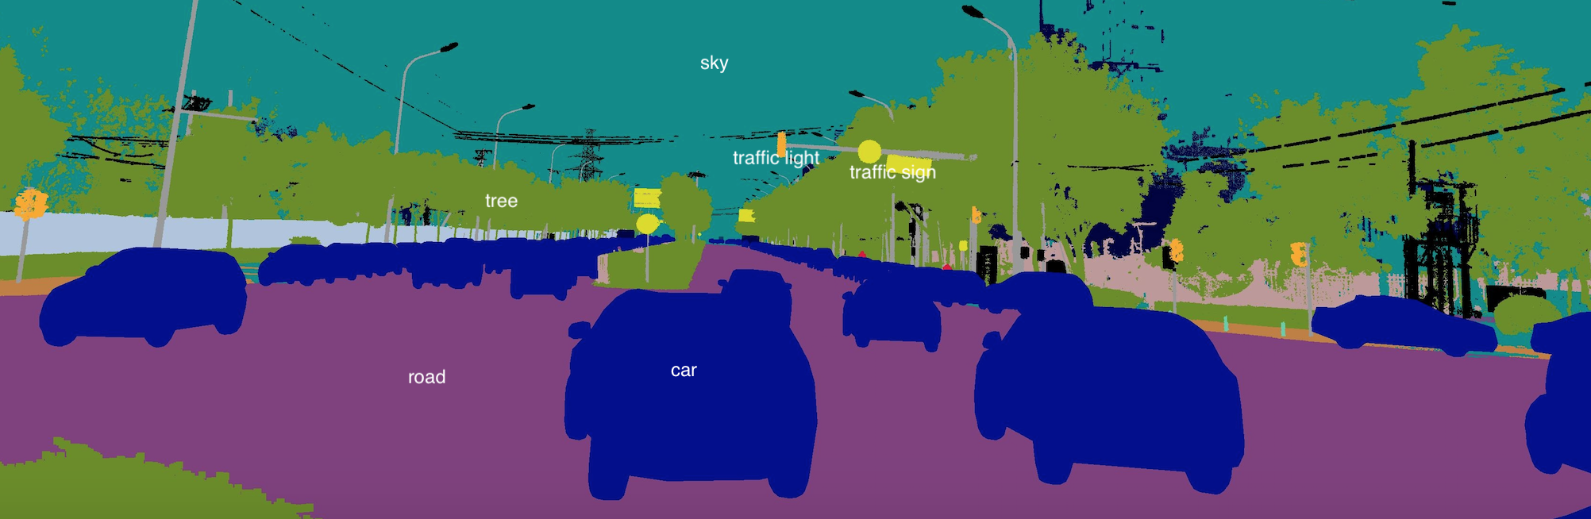
What? - Semantic segmentation
Assign each pixel in the image a category label
Notes:
Semantic segmentation is very helpful for the car to avoid obstacles, plan routes.
But it is not enough.
Though semantic segmentation can label every pixel, it can’t extract deeper information.
For example, the car know that there is traffic light in front, but it doesn’t know whether it should go ahead, because it doesn’t know whether the light is green or red.
In conclusion, by semantic segmentation, the car know what object is around, but the car doesn’t know the detailed information of the object.
This leads to our next task: traffic object content identification.

Slide 6
What? - Traffic object content identification
Notes:
We have to do traffic object content identification for some important object.
In the project, we will just focus on the most important 2 traffic objects: the traffic light, the road.
We pick the pixels from the original image corresponding to the object in the segmented image to analyze.
For traffic light identification, maybe analyze the color will be enough for us.
In order to identifying the lane markings on the road, we may do further segmentation for the road.
Anyway, we need to do some experiments next.

Slide 7
What? - Driving environment perception framework

Slide 8
How?
Dataset
Baidu autonomous driving dataset
Semantic segmentation
Fully Convolutional Network, SegNet, DilatedConv
Traffic object content identification
For traffic light: color analyzing
For road lane markings: line detection, further semantic segmentation
Notes:
Actually, we have done some survey on how to implement our system.
Except for computer vision skills, we have to use popular deep learning methods to achieve our goals, especially for the semantic segmentation part.
For semantic segmentation:
One of the most popular CNN based work is the Fully Convolutional Network (FCN) .
SegNet, DilatedConv are improvements for Fully Convolutional Network.
We may begin our work by studying their research paper and source code, and make some improvements.
For traffic object content identification, well for different traffic objects, we may apply different methods.
For example, to identify different traffic light, some color analyzing may be enough.
For road lane markings, we may have to apply some line detection techniques or do further segmentation for the road.

Slide 9
Comparison of different Semantic Segmentation Models
FC-DenseNet
3 Models
DeepLabv3
DeepLabv3+
Notes:
Because our project focuses on Applications, we tested 3 different semantic segmentation models in auto-driving application.

Slide 10
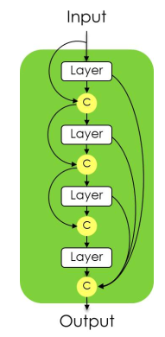
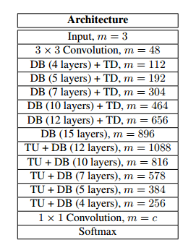
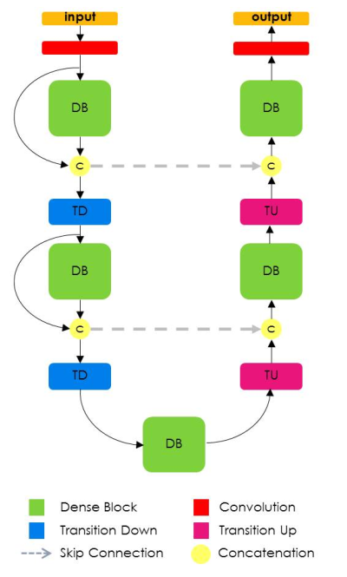
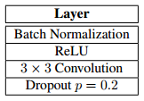
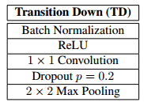
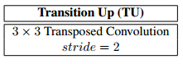
Semantic Segmentation Models—FC-DenseNet
FC-DenseNet103 model
fFADD
A dense block of 4 layers
FC-DenseNet
Notes:
The first model is FC-DenseNet model, The idea of DenseNets is based on the observation that if each layer is directly connected to every other layer in a feed-forward fashion then the network will be more accurate and easier to train.
The FC-DenseNet model was extended from DenseNets to work as FCNs by adding an upsampling path to recover the full input resolution. In order to solve large amount of computation and number of parameters problem, FC-DenseNet only upsample the feature maps created by the preceding dense block. Moreover, given the network architecture, the upsampled dense block combines the information contained in the other dense blocks of the same resolution. The higher resolution information is passed by means of a standard skip connection between the downsampling and the upsampling paths. The details of FC-DenseNet model are shown in the Figure

Slide 11
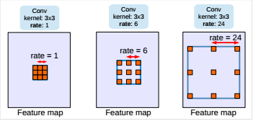
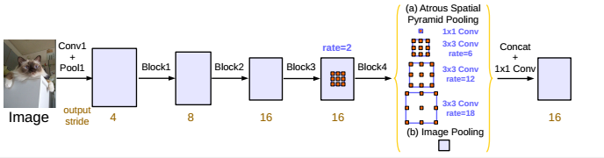
Semantic Segmentation Models--DeepLabv3
Frontend:ResNet-101
Atrous convolution with kernel size 3*3 and different rate
Parallel modules with atrous convolution (ASPP), augmented with image-level features
Notes:
The second network we chose is the deeplab v3，we revisit atrous convolution, a powerful tool to explicitly adjust filter’s field-of-view as well as control the resolution of feature responses computed by Deep Convolutional Neural Networks, in the application of semantic image segmentation. To handle the problem of segmenting objects at multiple scales, we design modules which employ atrous convolution in cascade or in parallel to capture multi-scale context by adopting multiple atrous rates. Furthermore, we propose to augment our previously proposed Atrous Spatial Pyramid Pooling module, which probes convolutional features at multiple scales, with image-level features encoding global context and further boost performance.

Slide 12
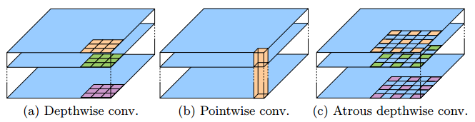
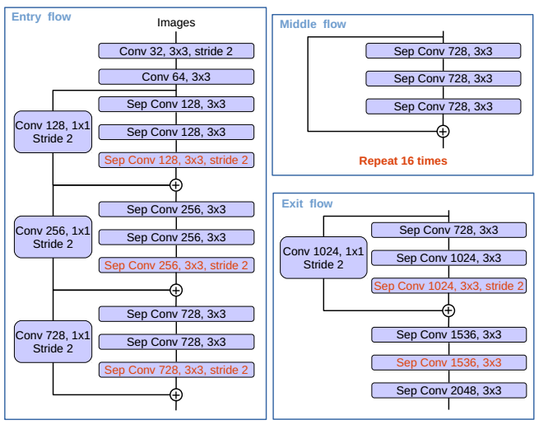
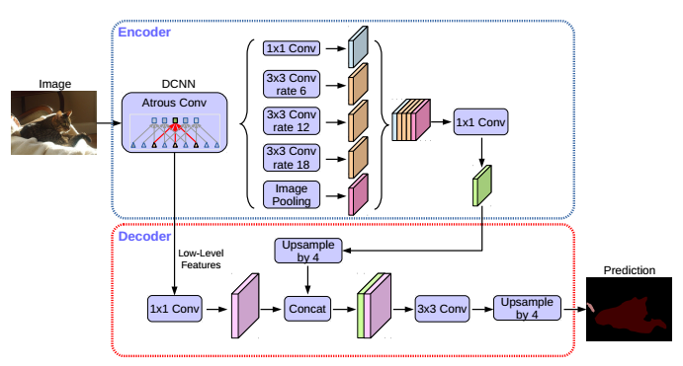
Semantic Segmentation Models--DeepLabv3+
Frontend:ResNet-101
Notes:
DeepLabv3+ extends DeepLabv3 by employing a encoder decoder structure. The encoder module encodes multi-scale contextual information by applying atrous convolution at multiple scales, while the simple yet effective decoder module refines the segmentation results along object boundaries.
We further explore the Xception model and apply the depthwise separable convolution to both Atrous Spatial Pyramid Pooling and decoder modules, resulting in a faster and stronger encoder-decoder network.

Slide 13
Why?
A lot of applications can be developed based on the driving environment perception framework
Examples:
Autonomous driving
AR navigation
Traffic violation behaviors identification
Notes:
As we said before, we want to build a driving environment perception framework,
and we want to develop applications and do research based on this framework.
Here are some application examples.
Autonomous driving is very hot in recent years.
AR navigation will help to provide better navigation experience for drivers.
Actually, I am really in traffic violation behaviors identification.
Based on such framework, it would be easy to detect red light violation or solid line crossing violation.
We may not have time to do applications this semester, but we will continue this work for our future research.
I think this framework is the basis for some of our future research.
This is why we choose to do this project.
If we have finish the project very well, I think we can make it open-source.
Then, all people can develop applications, do researches based on this framework.

Slide 14
Thank you

